Slide 1

Database Processing: Fundamentals, Design, and Implementation
15th Edition
Week #6
SQL for Database Construction and Application Processing

Slide 2
SQL Categories
SQL statements can be divided into five categories:
Data definition language (DDL)
Data manipulation language (DML) statements
SQL/Persistent Stored Modules (SQL/PSM) statements
Transaction control language (TCL) statements
Data control language (DCL) statements

Slide 3
SQL DDL and SQL DML
Data definition language (DDL) statements
Used for creating tables, relationships, and other structures
Data manipulation language (DML) statements
Used for:
Queries – SQL SELECT statement
Inserting data – SQL INSERT statement
Modifying data – SQL UPDATE statement
Deleting data – SQL DELETE statement

Slide 4
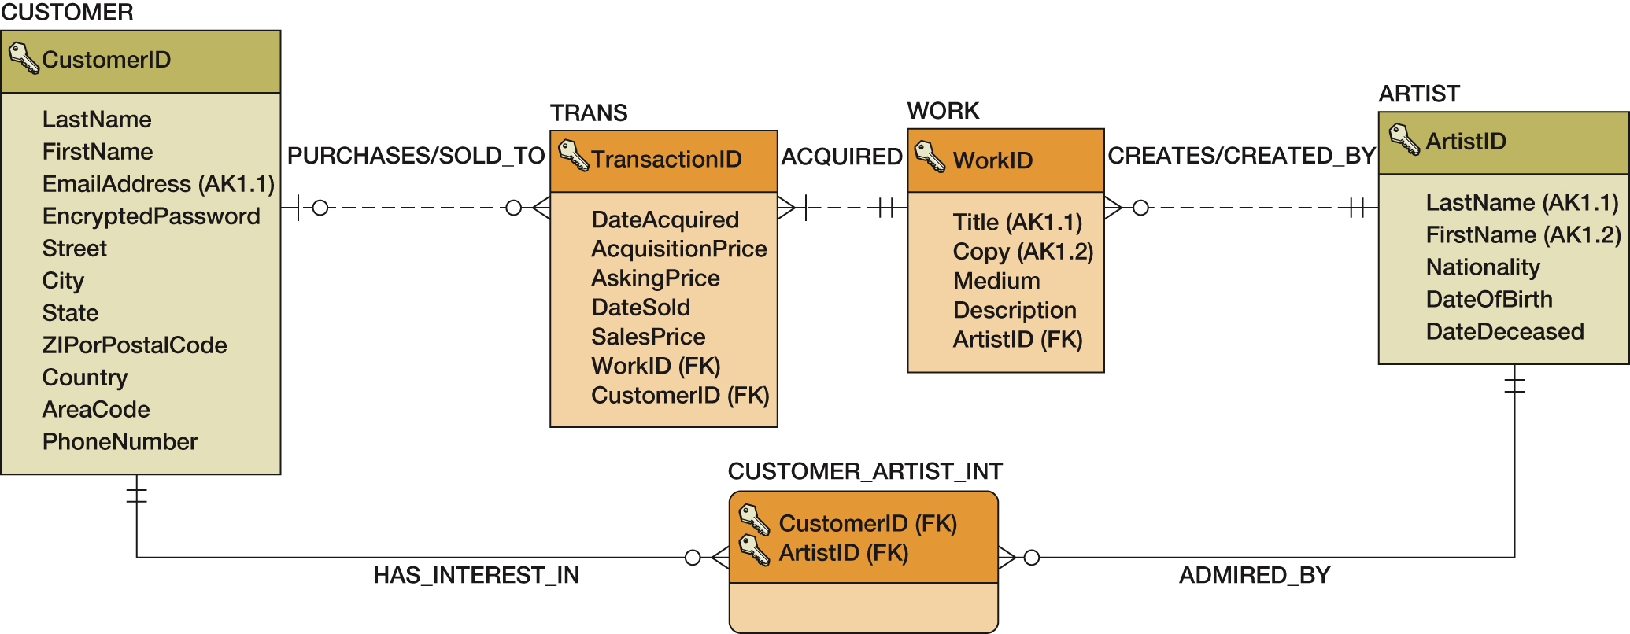
View Ridge Gallery (VRG) Database Design

Slide 5
The SQL CREATE TABLE Statement
CREATE TABLE statement is used for creating relations.
Each column is described with three parts: column name, data type, and optional constraints.
CREATE TABLE NewTableName(
ColumnName DataType OptionalConstraint,
ColumnName DataType OptionalConstraint,
...
Optional table constraint
...
);

Slide 6
Column and Table Constraints
Constraints can be defined within the CREATE TABLE statement, or they can be added to the table after it is created using the ALTER table statement.
Column and table constraints include:
PRIMARY KEY ─ may not have NULL values
FOREIGN KEY ─ may not have NULL values
NULL / NOT NULL
UNIQUE
CHECK
The DEFAULT keyword (not a constraint) can be used to set initial values.

Slide 7
Column Characteristics for the VRG ARTIST Table
Column Name | Type | Key | NULL Status | Remarks
ArtistID | Int | Primary Key | NOT NULL | Surrogate Key IDENTITY (1,1)
LastName | Char (25) | Alternate Key | NOT NULL | AK1.1
FirstName | Char (25) | Alternate Key | NOT NULL | AK1.2
Nationality | Char (30) | No | NULL
DateOfBirth | Numeric (4,0) | No | NULL
DateDeceased | Numeric (4, 0) | No | NULL

Slide 8
Column Characteristics for the VRG WORK Table
Column Name | Type | Key | NULL Status | Remarks
WorkID | Int | Primary Key | NOT NULL | Surrogate Key IDENTITY (500,1)
Title | Char (35) | Alternate Key | NOT NULL | AK1.1
Copy | Char (12) | Alternate Key | NOT NULL | AK1.2
Medium | Char (35) | No | NULL
Description | Varchar (1000) | No | NULL | DEFAULT value = ‘Unknown provenance’
ArtistID | Int | Foreign Key | NOT NULL

Slide 9
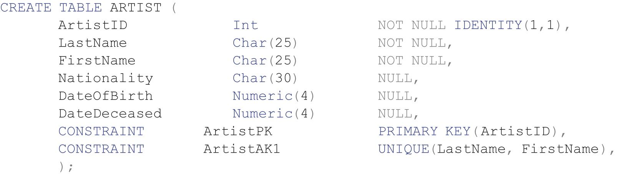
SQL Statement to Create the VRG ARTIST Table
SQL CREATE TABLE statement:

Slide 10
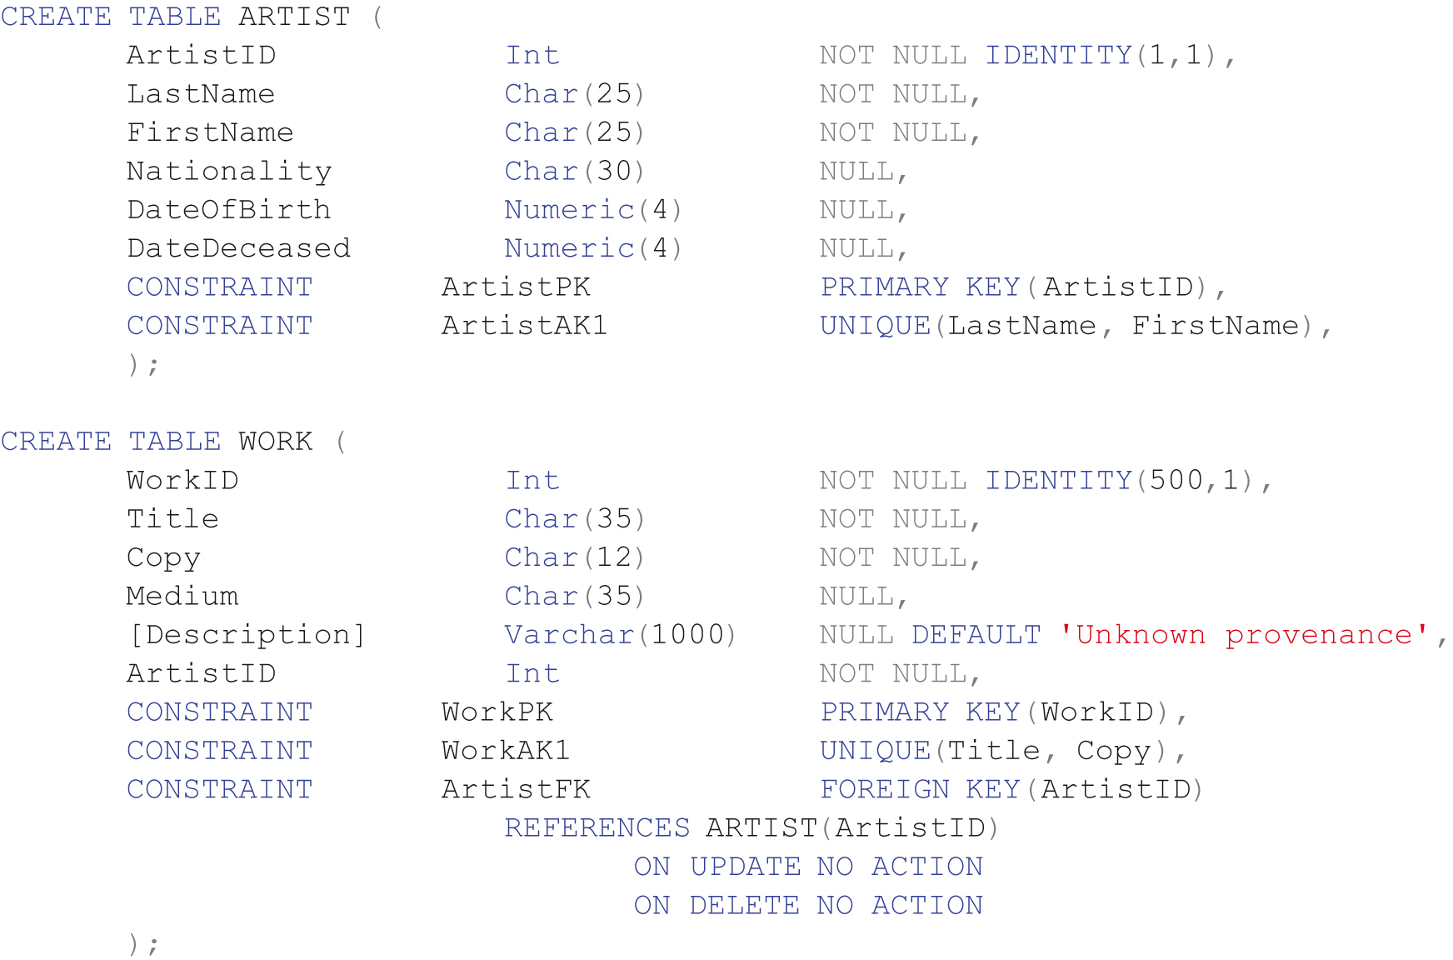
SQL Statement to Create the VRG ARTIST-to-WORK 1:N Relationship

Slide 11
Default Values and Data Constraints for the VRG Database
Table | Column | Default Value | Constraint
WORK | Description | ‘Unknown provenance’
ARTIST | Nationality |  | IN (‘Canadian’, ‘English’, ‘French’, German’, ‘Mexican’, ‘Russian’, ‘Spanish’, ‘United States’)
ARTIST | DateOfBirth |  | Less than DateDeceased
ARTIST | DateOfBirth |  | Four digits – 1 or 2 is first digit, 0 to 9 for remaining three digits.
ARTIST | DateDeceased |  | Four digits – 1 or 2 is first digit, 0 to 9 for remaining three digits.
TRANS | SalesPrice |  | Greater than 0 and less than or equal to 500,000.
TRANS | DateAcquired |  | Less than or equal to DateSold

Slide 12
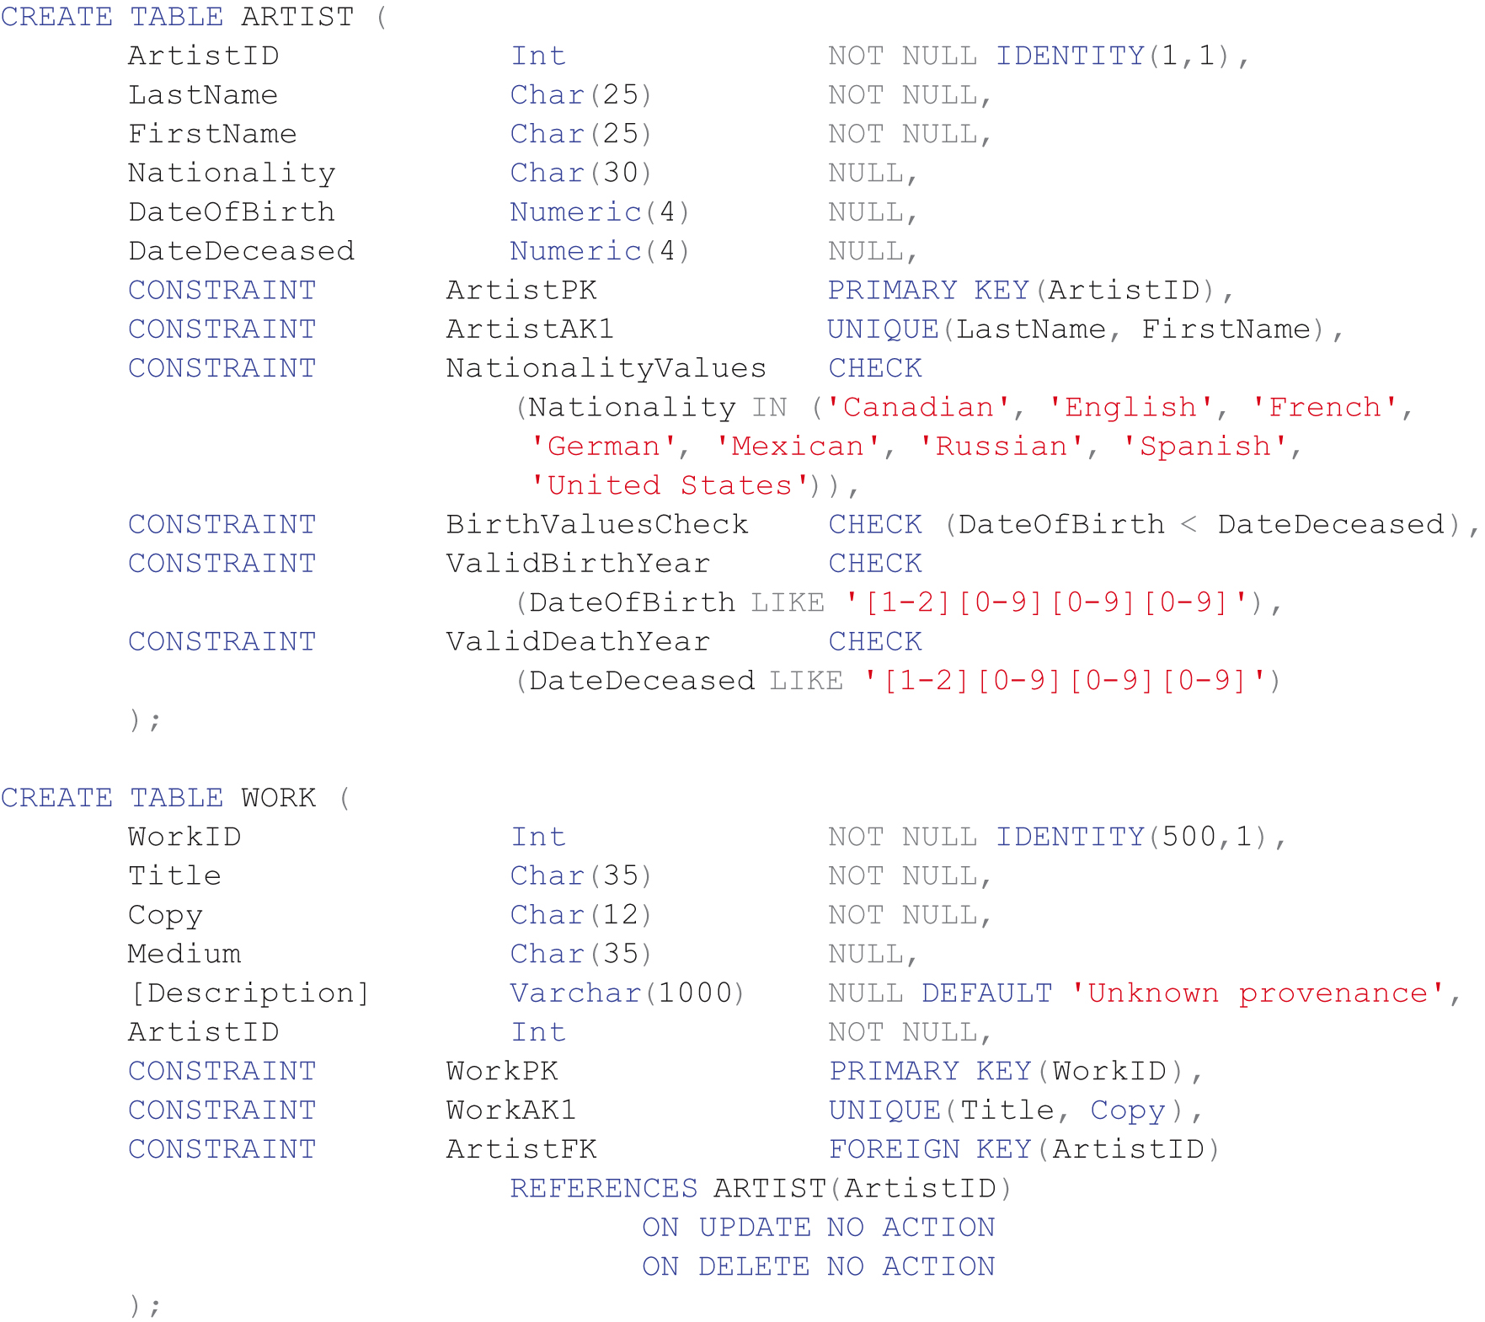
SQL Statement to Create the ARTIST and WORK tables with Constraints

Slide 13
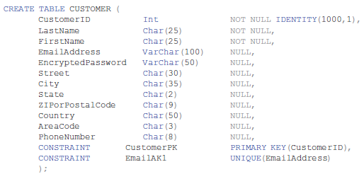
SQL Statements to Create the VRG CUSTOMER Table

Slide 14
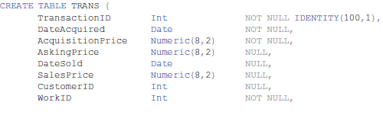
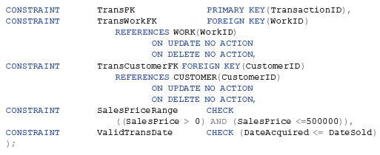
SQL Statements to Create the VRG TRANS Table

Slide 15
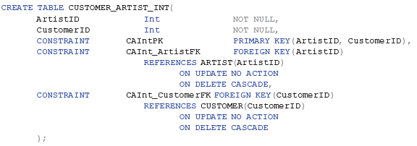
SQL Statements to Create the VRG CUSTOMER_ARTIST_INT Table

Slide 16
The SQL ALTER TABLE Statement
The SQL ALTER TABLE statement is an SQL DDL statement that is used to change the structure of an existing table.
It can be used to add, remove, or change columns.
It can be used to add or remove constraints.

Slide 17
Adding and Dropping Columns
The following statement will add a column named MyColumn to the CUSTOMER table:
ALTER TABLE CUSTOMER
ADD MyColumn Char(5) NULL;
The following statement will drop an existing column:
ALTER TABLE CUSTOMER
DROP COLUMN MyColumn;
Note the SQL COLUMN keyword is used only when dropping a column and not when adding one!

Slide 18
Adding and Dropping Constraints
The SQL ADD CONSTRAINT can be used to add a constraint:
ALTER TABLE CUSTOMER
ADD CONSTRAINT MyConstraint CHECK
(LastName NOT IN ('Robertson'));
The SQL DROP CONSTRAINT can be used to drop a constraint:
ALTER TABLE CUSTOMER
DROP CONSTRAINT MyConstraint;

Slide 19
Removing Tables
It is easy to remove a table in SQL.
BUT, be very careful to drop the correct table because you also drop all of its data!
SQL code to drop a table:
DROP TABLE TRANS;

Slide 20
Dropping the CUSTOMER Table (1 of 2)
The following statement will drop the CUSTOMER table. Note that the other two tables need to be dropped also because of the constraints on the CUSTOMER table.
DROP TABLE CUSTOMER_ARTIST_INT;
DROP TABLE TRANS;
DROP TABLE CUSTOMER;

Slide 21
Dropping the CUSTOMER Table (2 of 2)
As an alternative, we can drop only the CUSTOMER table if we first drop the constraints associated with the other two tables as follows:
ALTER TABLE CUSTOMER_ARTIST_INT
DROP CONSTRAINT CAInt_CustomerFK;
ALTER TABLE TRANS
DROP CONSTRAINT TransCustomerFK;
DROP TABLE CUSTOMER;

Slide 22
The SQL TRUNCATE TABLE Statement
The SQL TRUNCATE TABLE statement is used to remove all data from a table while leaving the table structure intact as seen below:
TRUNCATE TABLE CUSTOMER_ARTIST_INT;
Cannot be used with a table that is referenced by a foreign key constraint.
Resets surrogate key values to their initial value.

Slide 23
The SQL INSERT Statement
The SQL INSERT Statement is used to add rows of data to an existing table.
INSERT INTO ARTIST
(LastName, FirstName, Nationality, DateOfBirth, DateDeceased)
VALUES ('Miro', 'Joan', 'Spanish', 1893, 1983);
INSERT INTO ARTIST
(LastName, FirstName, Nationality)
VALUES ('Miro', 'Joan', 'Spanish');

Slide 24
Using the Bulk INSERT
You can insert bulk data from another table by using the INSERT statement.
INSERT INTO ARTIST
(LastName, FirstName, Nationality, DateOfBirth, DateDeceased)
SELECT LastName, FirstName, Nationality,
DateOfBirth, DateDeceased
FROM IMPORTED_ARTIST;

Slide 25
The SQL UPDATE Statement
The SQL UPDATE Statement is used to change values of existing rows.
Example: Change the City value to ‘New York City’ in the VRG database for CustomerID = 1000.
UPDATE CUSTOMER
SET City = 'New York City’
WHERE CustomerID = 1000;
To change the value of both city and state:
UPDATE CUSTOMER
SET City = 'New York City', State = 'NY’
WHERE CustomerID = 1000;

Slide 26
The Bulk UPDATE (1 of 2)
UPDATE CUSTOMER
SET City = 'New York City’;
Warning! If you execute the above statement you will change every row in the CUSTOMER table.
Be sure to include a WHERE statement to show only those customers you really want to change!

Slide 27
The Bulk UPDATE (2 of 2)
Update the CUSTOMER table by changing the area code for every customer who lives in Denver to ‘303’.
UPDATE CUSTOMER
SET AreaCode = '303’
WHERE City = 'Denver’;
Notice the WHERE statement in the code above.

Slide 28
The SQL MERGE Statement (1 of 2)
The SQL MERGE Statement essentially combines the SQL INSERT and SQL UPDATE statements into one statement that can either insert or update data depending upon whether some condition is met.

Slide 29
The SQL MERGE Statement (2 of 2)
MERGE INTO ARTIST AS A USING ARTIST_DATA_RESEARCH AS ADR
ON (A.LastName = ADR.LastName
AND
A.FirstName = ADR.FirstName)
WHEN MATCHED THEN
UPDATE SET
A.Nationality = ADR.Nationality,
A.DateOfBirth = ADR.DateOfBirth,
A.DateDeceased = ADR.DateDeceased
WHEN NOT MATCHED THEN
INSERT (LastName, FirstName, Nationality, DateOfBirth, DateDeceased)
VALUES (ADR.LastName, ADR.FirstName,
ADR.Nationality, ADR.DateOfBirth, ADR.DateDeceased);

Slide 30
The SQL DELETE Statement
SQL DELETE statement:
DELETE FROM CUSTOMER
WHERE CustomerID = 1000;
If you omit the WHERE clause, you will delete every row in the table.
Does not reset surrogate key values

Slide 31
Using SQL Views
An SQL view is a virtual table that is constructed from other tables or views.
It has no data of its own, but obtains data from tables or other views.
SELECT statements are used to define views:
A view definition may not include an ORDER BY clause
SQL views are a subset of the external views:
They can be used only for external views that involve one multivalued path through the schema

Slide 32
SQL CREATE VIEW Statement (1 of 2)
Create the CustomeNameView on the CUSTOMER table that displays the customer’s LastName and FirstName and rename the fields.
CREATE VIEW CustomerNameView AS
SELECT LastName AS CustomerLastName,
FirstName AS CustomerFirstName
FROM CUSTOMER;
Views do NOT support the ORDER BY clause, thus you cannot sort within a view.

Slide 33
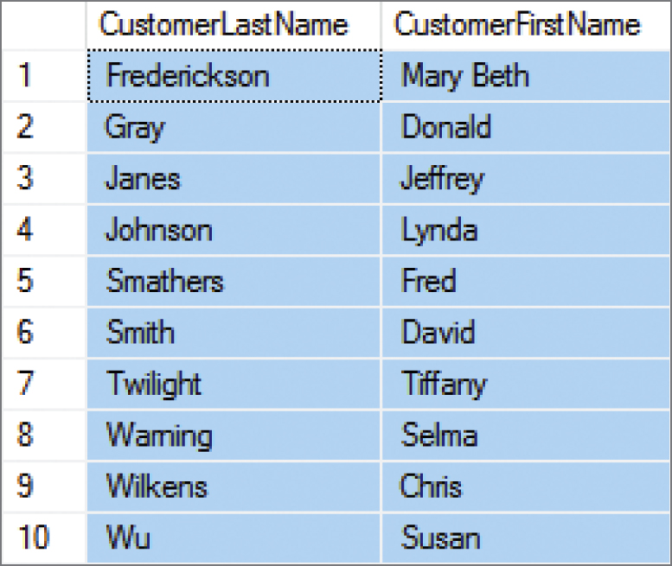
SQL CREATE VIEW Statement (2 of 2)
To see the results, use an SQL SELECT statement with the view name as the table name in the FROM clause as shown below.
SELECT *
FROM CustomerNameView
ORDER BY CustomerLastName,
CustomerFirstName;
Notice you can now sort!

Slide 34
The SQL ALTER VIEW Statement
You can use the ALTER VIEW Statement to change an SQL view after it has been created.
ALTER VIEW CustomerNameView AS
SELECT FirstName AS CustomerFirstName,
LastName AS CustomerLastName,
FROM CUSTOMER;

Slide 35
Database Processing Fundamentals, Design, and Implementation (15th Edition)
End of Presentation:
Week #6

